Slide 1
SOFTWARE REQUIREMENTS ENGINEERING
LECTURE # 5
PROBLEM ANALYSIS

Slide 2
Presentation Outline
4
The Software Team
Problem Analysis
5 Steps of Problem Analysis
Gain Agreement on the Problem Definition
Understand the Root Causes
Identify the Stakeholder and Users
Define the Solution System Boundary
Identify the constraints to be imposed on the solution

Slide 3

TheSoftware Team
5

Slide 4

TheSoftware Team
6
Effective requirements management an effective software team.
can be accomplished only by
Requirements management touches every team member in different ways.
Effective requirements management requires mastering six team skil s.

Slide 5
Team Members Have Different Skills
7
One of the most interesting things about teams is that individual team members have different skills, that's what makes a team a team.
In the software team, we hope that
Some players have proven their ability to work with the customers effectively,
Some have software programming abilities, and that
others have testing abilities.
Still other team players will need design and architecture abilities.
Many more skils are required aswell.

Slide 6
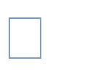
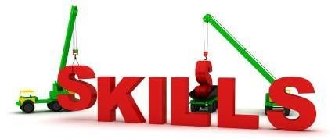
Requisite Team Skills for Effective Requirements Management
8
six team skills that successfuly address
are necessary for a modern software team to the requirements chal enge are mentioned here
Team Skill 1, Analyzing the Problem
Team Skill 2, Understanding User and Stakeholder Needs
Team Skill 3, Defining the System Team Skill 4, Managing Scope
Team Skill 5, Refining the System Definition Team Skill 6, Building the Right System

Slide 7
Requirements Engineer /
Analyst [2]
9
Requirements Engineer/ IT Business Analyst is
charged with working
with
the project
document the
stakeholders and end users to elicit, understand, analyze, and requirements for a system in order to solve a given business problem.
Other common titles for this role are: Requirements Analyst, Functional Architect, Business Systems Analyst, Business Analyst (generic term), etc.
Requirements analyst is a project role, not necessarily a job title. One or more dedicated specialists can perform the role, or it may be assigned to any of a number of team members: the project manager, product manager, developer e.t.c
Nevertheless, a talented analyst can make the difference between project success or failure.

Slide 8
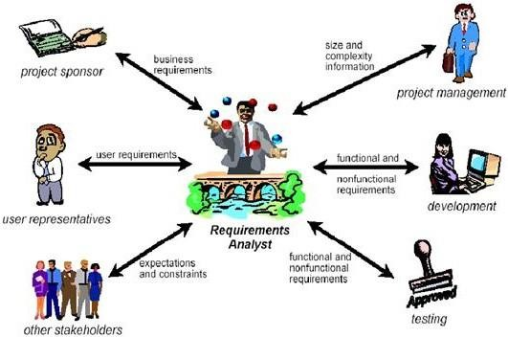
Requirements Engineer /
Analyst [2]
10

Slide 9


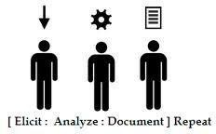
Tasks of Requirements Engineer /Analyst [2]
11
Define Business Needs.
Identify Project Stakeholders and user classes
Elicit Requirements
Analyze Requirements
Write Specifications

Slide 10
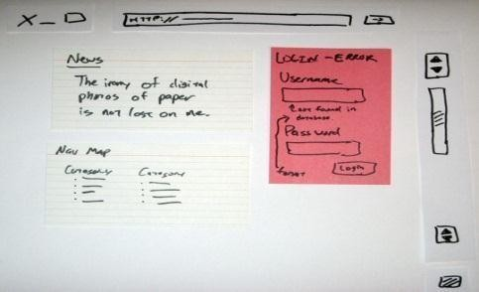
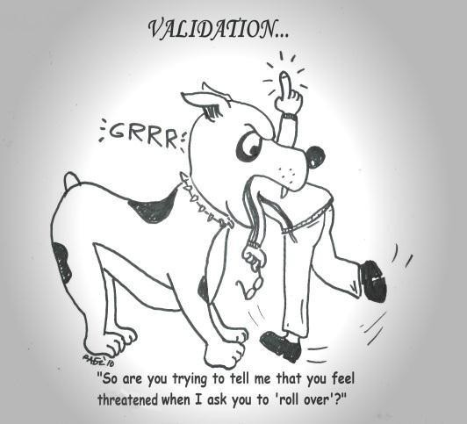

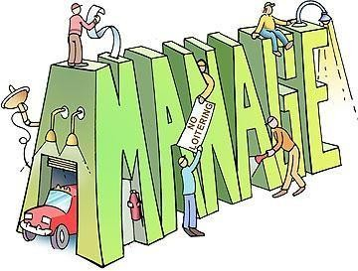
Tasks of Requirements Engineer /Analyst [2]
12
Model the Requirements
Lead Validation
Facilitate
Prioritization
Manage Requirements

Slide 11

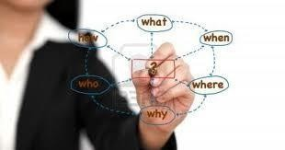
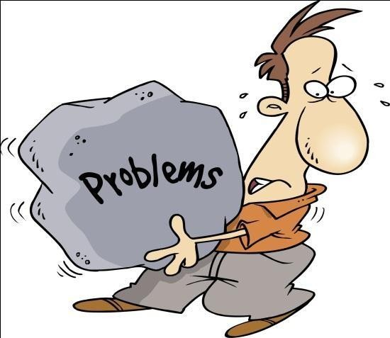
Problem Analysis [1]
13
Problems and opportunities are just flip sides of the same coin; your problem is my opportunity.
Problem analysis is the process of understanding real-world problems and user's needs and proposing solutions to meet those needs.
Problem domain must be analyzed and understood, explore a variety of solution domains.
Find the optimal solution for the problem among the variety of solutions.
In order to be able to do problem analysis, we should know what a problem is, a problem can be defined as the difference between things as perceived and things as desired.

Slide 12

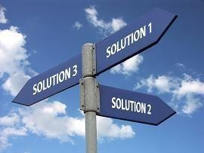

Problem Analysis [1]
14
Sometimes, the simplest solution is a workaround, or
revised business process, rather than a new system.
Changing the user's desire or perception may be the most
cost-effective approach to address a problem.
Practical experience shows many examples where changing the perception led to the highest-quality, fastest, and cheapest solutions available
As problem solvers, it is recommended to explore these alternative solutions before leaping into a new system solution.
However, when these alternative activities fail to reduce this gap, then we have to actively change the distance between perception and desire by defining and implementing new systems

Slide 13
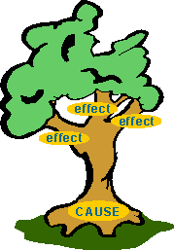


Steps of Problem Analysis [1]
15
The goal of problem analysis is to gain a better understanding of the problem being solved., before development begins,
Gain agreement on the problem definition.
Understand the root causes—the problem behind the problem.
Identify the stakeholders and the users.
Define the solution system boundary.
Identify the constraints to be imposed on the solution.

Slide 14
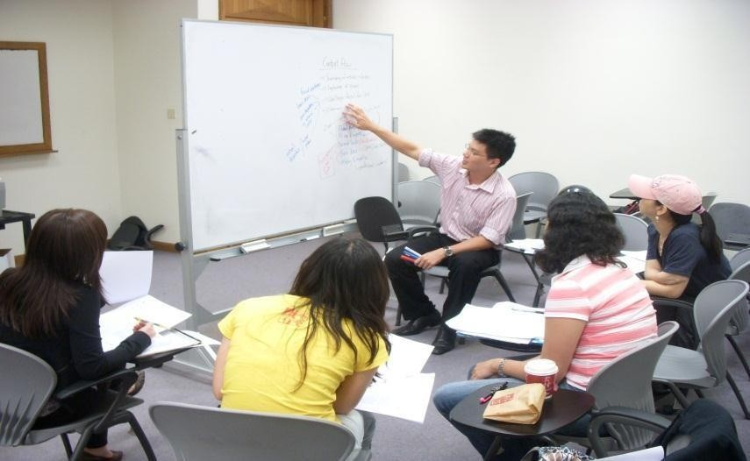
Gain Agreement on the problem definition
₁₆[1]
Thefirst step is to gain agreement on the definition of the problem to be solved.
One of the simplest ways to gain this agreement is to simply write the problem down and see whether everyone agrees.
It is often helpful to understand someof the benefits of a proposed solution
Having the user describe the benefits provides additional contextual background on the real
problem.

Slide 15
The problem Statement
17
You may find it helpful standardized format (T able 1).
to write your problem down in a
Table 1: Problem Statement Format
Problem | Description
The Problem of | Describe the problem.
Affects | Identify stakeholders affected by the problem.
The result of which | Describe the impact of this problem on stakeholders and business activity.
Benefits of | Indicate the proposed solution and list a few key benefits.

Slide 16
Step 2: Understand the Root Causes
18
Once you have an understanding of the larger problem, your team can use a variety of techniques to gain an understanding of its causes.
One such technique is root cause analysis, which is a systematic way of uncovering the root, or underlying, cause of an identified problem.
For example,
consider a real-world example: a company, GoodsAreUs, manufactures and sells a
variety of inexpensive, miscellaneous items for home and personal use.
As the company addressesthe problem of insufficient profitability, it uses total quality management (TQM) techniques for problem solving
Based on this experience, the company quickly focused on its cost of nonconformance, which is the cost of all the things that go wrong and produce waste, scrap, and other excess costs.

Slide 17
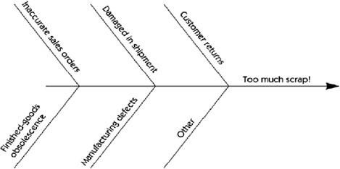
Step 2: Understand the Root Causes
19
This cost includes rework, scrap, customer dissatisfaction, employee turnover, and other factors that are negative-value activities.
Production waste, or "scrap," was found to be one of the largest contributors after quantification of its cost of non quality.
This problem of excess scrap, then, is the next problem the company is trying to solve since it directly affects the larger problem of the cost of nonconformance, which in turn affects profitability
TQM teaches us the use of the fishbone diagram (see Figure 1) to identify the problems behind the problem. Each source that contributes towards failure are listed as one of the "bones" on the diagram.
Figure 1: Fishbone diagram of RootCauses

Slide 18
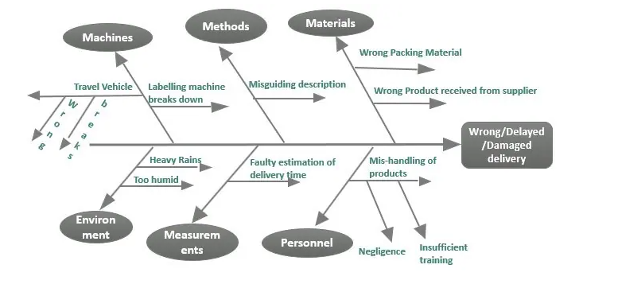
Example
Let’s try an example where the problem that needs our attention is wrong/delayed/damaged delivery. The possible reasons can be many like the faulty packaging was used that led to damage during transit, the wrong product was released for delivery, or the address label on the product wasn’t correct. We can classify the same in main causes and present it in the fishbone diagram like below

Slide 19
Example -2
Let’s take one more example. Looking at how well we addressed the above problem, we have hired on as consultants by a burger store to identify the reasons that can lead to the preparation of a bad quality-burger. The question sounds tasty. I mean engaging, doesn’t it?

Slide 20

Step 2: Understand the Root Causes
20
OK, so how do you determine the root causes? In many cases, it's a simple matter of asking the people directly involved what they think the root cause is.
If the problem is more serious then it may be necessary to perform a detailed investigation of each contributing problem and to quantify its individual impact.
This could vary from perhaps simple brainstorming by participants to a small data
collection project or, potentially, to a more detailed experiment.

Slide 21
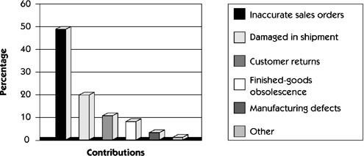
Addressing the Root Cause
21
We might like to fix all of the root causeson the "bones" of the diagram.
But data shows that a number of root causes are simply not worth fixing, as the cost of the fix exceeds the cost of theproblem.
How do you know which ones to fix? You must determine the contribution, of each root cause. The results of this investigation can be plotted as a Pareto chart [3] or a simple histogram [4] that visually exposes the real culprits.
Figure 4: Pareto Chart of RootCauses

Slide 22
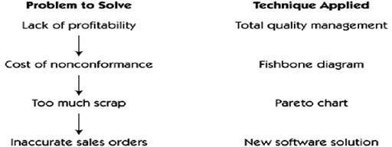
Addressing the Root Cause
22
let's look at the problem analysis sequence that got us here
A further fishbone analysis could then be used to determine errors contribute to the inaccurate sales order problem.
what
specific types of
This new, more detailed data can then be used to define the features of the software system to address those errors.
Figure : Applying different problem analysis techniques as the problem unfolds

Slide 23
Addressing the Root Cause
23
Once we have identified inaccurate sales orders as a root cause of a problem worth solving, we can create a problem statement for the sales order entry problem, as seen in Table 2
Table 2: Sales Order Problem Statement
Problem | Description
The Problem of | Inaccuracies in sales orders.
Affects | Sales order personnel, customers, manufacturing, shipping, and Customer service.
The result of which | Increased scrap, excessive handling costs, customer Dissatisfaction and decreased profitability
Benefits of | That creates a new system to address the problem include Increased accuracy of sales orders at point of entry Improved reporting of sales data to management Ultimately, higher profitability
Once written, the problem statement can be circulated to the stakeholders for comment and feedback.

Slide 24
Addressing the Root Cause
24
Example 2
Table 3: Attendance System ProblemStatement
Problem | Description
The Problem of | Student Attendance Management.
Affects | Teacher. Students. Attendance Department.
The result of which | Teacher-- Has to take some precious time and energy out of the lecture and take attendance. Student-- If misses calling the attendance then it’s a absent mark for him. Attendance Department-- The department has to print hundreds of pages on daily bases to maintain attendance. After the teacher marks attendance the attendance sheet is taken to department and attendance is manually entered
Benefits of | Totally automates the process of taking attendance. Reduces the role of attendance department in printing attendance sheet and then manually entering the attendance record.
❑ Once written, th
e problem statement can be circulated to the stakeholders for comment and
feedback.

Slide 25
Step 3: Identify the Stakeholders and the Users
25
Understanding the needs of the users and other stakeholders is a key factor in developing an effective solution.
Effectively solving any complex problem typically involves satisfying the needs of a
diverse group of stakeholders.
Many stakeholders are users of the system, and their needs are easy to focus on because they will be directly involved with system use.
However, some stakeholders are only indirect users of the system or are affected only by the business outcomes that the system influences.
For example, they include the people and organizations involved in the development of the system, the subcontractors, the customer's customer, e.t.c
Non user stakeholder needs must also be identified and addressed.

Slide 26
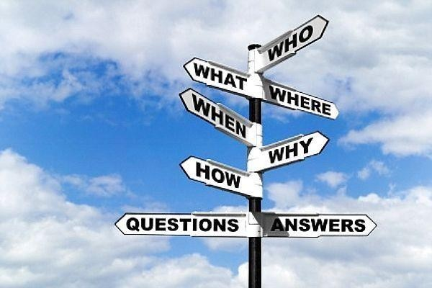
Step 3: Identify the Stakeholders and the Users
26
The following questions can be helpful in this process.
Who are the users of the system?
Who is the customer (economic buyer) for the system?
Who else will be affected by the outputs the system produces?
Who will evaluate and approve the system when it is delivered and deployed?
Are there any other internal or external users of the system whose needs must be addressed?
Who will maintain the new system?
Is there anyone else who cares?

Slide 27

Step 4: Define the Solution System Boundary
27
Once the problem statement is agreed to and the users and stakeholders are identified, we can turn our attention to defining a system that can be deployed to address the problem.
In so doing, we enter an important transition state wherein we have to keep two things in mind:
an understanding of the problem and
the considerations of a potential solution.
The next important step is to determine the boundaries of the solution system. The system boundary defines the border between the solution and the real world that surrounds the solution (Figure 4).
Information, in the form of inputs and outputs, is passed back and forth from
the system to users.
Figure 4: The inputs/system/outputs relationship

Slide 28
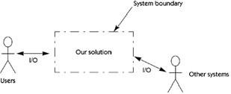
Step 4: Define the Solution System Boundary
28
We divide the world in two:
Our System
Things that interact with our system
Let's identify the "things that "actors on our system."
Once we understand the concept boundary as shownin Figure 5
interact with our system" generically as
of an actor, we can illustrate a system
Figure 5: The inputs/system/outputs relationship

Slide 29
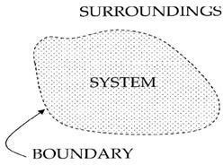
Step 4: Define the Solution System Boundary
29
How do we find these actors? Here are some helpful questions to ask.
Who will supply, use, or remove information from the system?
Who will operate the system?
Who will perform any system maintenance?
Where will the system be used?
Where does the system get its information?
What other external systems will interact with the system?

Slide 30
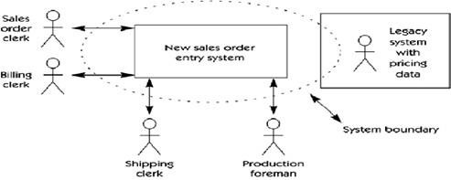
Step 4: Define the Solution System Boundary
30
After identifying the actors, the analyst can now create a "system perspective," a block diagram that describes the boundaries of the system, the users, and other interfaces. Figure 6 provides a system perspective for the new sales order system.
The dotted line illustrates the system boundary for the proposed solution. The diagram shows that in order to solve our problem we will have to both develop a new system and modify some elements of the existing system (legacy system).
Figure 5: System Perspective

Slide 31

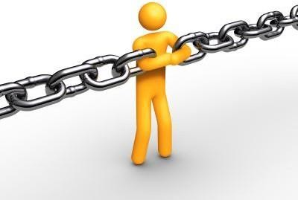
Step 5: Identify the Constraints to Be Imposed on the Solution
31
Constraints are restrictions on the degrees of freedom when providing a solution
Each constraint has the potential to severely restrict our ability to deliver
a solution as we visualize it. Therefore, each constraint must be carefully considered as part of the planning process.
A variety of sources of constraints must be considered.
These constraints may be given to us before we even begin or we may have to actively elicit them.

Slide 32
Step 5: Identify the Constraints to Be Imposed on the Solution
32
Some potential sources of constraints are listed below
✓
✓
✓
✓
✓
✓
Economics Politics Technology Systems Environment
Schedule & Resources

Slide 33
References
33
1.
Managing Software Requirements: A UseCaseApproach, Second Edition By Dean Leffingwell, Don Widrig, Addison- Wesley
http://www.processimpact.com/articles/be_analyst.pdf
http://en.wikipedia.org/wiki/Pareto_chart
http://en.wikipedia.org/wiki/Histogram
2.
3.
4.

